Slide 1


INTEGRATED PROJECT – SUMMER 2024
Introduction to Machine Learning & K-Means Clustering
Team Arocha
Actuarial Science Program
May 30, 2024

Slide 2
TABLE OF CONTENTS
01 | What is Data Science?
02 | What is Machine Learning?
03 | Overview of K-Means Clustering

Slide 3
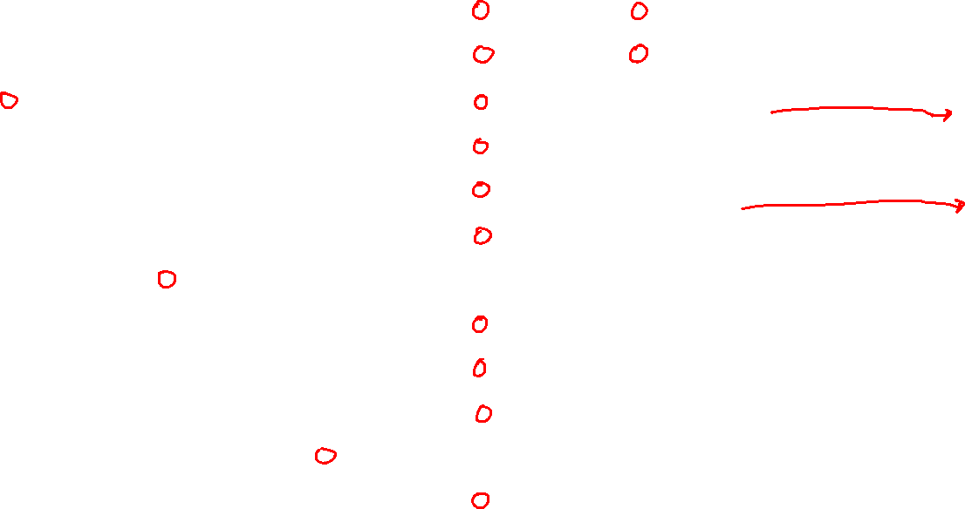

Slide 4
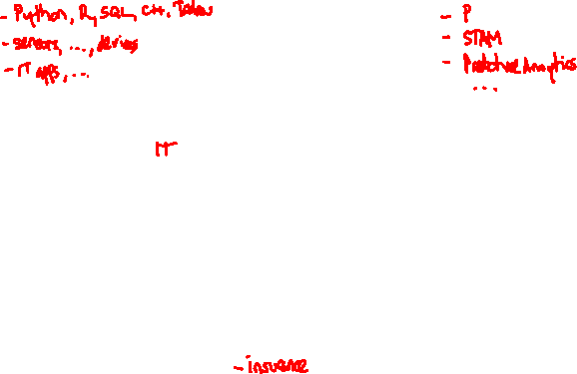
Data Science
Computer
Science
Machine Learning
& Deep Learning
Probability & Statistics
Data
Science
Software
Development
Research &
Development
Industry
Knowledge

Slide 5





Machine Learning
Machine learning is a subset of artificial intelligence (AI) that involves the development of algorithms and models that enable computers to learn from and make predictions or decisions based on data
Training Data
ML Model
Predictions
Future Data

Slide 6
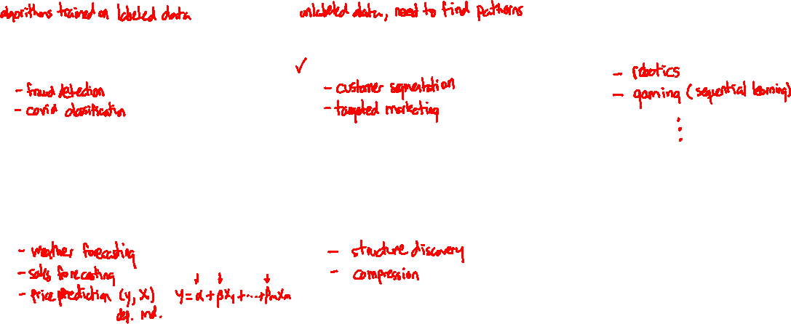
Types of Machine Learning
Machine learning can be broadly categorized into three main types:
Supervised Learning |  | Unsupervised Learning |  | Reinforcement Learning
Classification |  | Clustering
Regression |  | Dimensionality Reduction

Slide 7
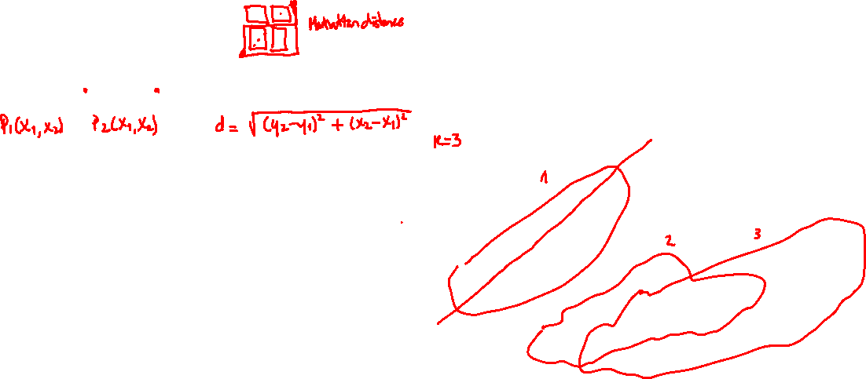
K-Means Clustering
K-Means clustering is an unsupervised machine learning algorithm used for partitioning a dataset into K distinct clusters.
The algorithm uses Euclidean distance to assign data points to the nearest cluster centroid.

